Slide 1
Cruz-Rabe Pharmacy Request System
Bueno x Rosales
CSPROJ
MI141

Slide 2
Business Requirements
In order to ensure patient's safety, cost effective processes and well managed admission on managing medical services, through preventing clinical errors and use resources efficiently. Therefore, business process should have a sufficient tool which is an automation of “Pharmacy Request System.” Transactions that are processed in different factors including; IN and OUT patient order entry, dispensing orders, pharmacy inventory and purchasing management will stand-alone by providing innovative way of service. The client Cruz-Rabe Maternity General Hospital uses the latest technology enabling complete control to improve medical management and to bring satisfaction to their clients in terms of professional service.

Slide 3
Backgound
A lot of people are laying their health safety in the hands of medical field professionals, with corresponding good quality equipment, and authorized medicines. These requirements, to ensure to have the right treatment, are all present in the developers’ chosen client; Cruz-Rabe Maternity and General Hospital, accredited as one of the secondary hospital in Taguig City and located at 37 General Luna St., Tuktukan, Taguig City. The hospital itself is a three-storey building that can accommodate 30 bed rooms over 50 patients. Cruz-Rabe Maternity & General Hospital was categorized as a private class hospital in Taguig City and owned by a family corporation.

Slide 4
Background Cont.
The hospital has associate subsidiaries namely; South Super Highway Medical Centre, the main hospital which can do major unitary operations. And the last one is General Trias Satellite Hospital, which is a gateway hospital in Cavite. These 3 hospitals were owned by Dr. Jose Casimiro Rabe, a family doctor and his wife Dra. Erlinda Cruz Rabe an ob-gyne. Cruz-Rabe Maternity & General Hospital had addressed its main problem particularly on the Pharmacy Booth section and which we think our project team can contribute a solution to their dilemma. Specifically, we proposed a system for the automation of their “Manual Process of Pharmacy Requests.”
A pharmacy within a hospital case, wherein there will only be IN and OUT patients for pharmacy request entry.

Slide 5
Business Opportunity
Based on the client’s needs, a Pharmacy Request System will make a huge difference in its line of work. There is sufficient amount of tools to help them do business processes but they are not enough to make it efficient. All transactions being done are in manual type of processing. Because of this, the developers decided to pick an area to develop wherein that factor does a critical role; the pharmacy. The pharmacy of Cruz-Rabe hospital has only two pharmacists, including the developers’ contact, Mrs. Carmelita Buenaflor. Mainly, her concern is the manual way of processing the prescription orders of the patients.

Slide 6
Business Opportunity Cont.
Since most likely, a pharmacy request slip needs to be transacted before allowing the patients to leave thus, having another aspect of system because most of the time, the order has already medicines required to be bought before the release. This is where the inventory side comes in. The Pharmacy Request System that will be made can cover all these factors in one place, a big business opportunity which must be done to ensure the efficiency of work especially with limited number of employees.

Slide 7
Business Objectives and Criteria
To eliminate undue resources by implementing Paperless Transactions System (PTS) through the use of the system.
Provides an electronic system that interacts with the patient and the pharmacy.
Offers convenient way of discharging patients by accumulating valuable records.

Slide 8
Business Objectives and Criteria Cont.
We can assume that the system will be feasible if we meet the following requirements:
If the system seems to be helpful when hospital transactions (pharmacy requests) are now processed in just a few moments.
If the results produced are accurate and reliable for the patients.
If the pharmacy records can be tracked down easily from its database.
If less resources are utilized but service would improve.

Slide 9
Business Objectives and Criteria Cont.
We can assume that the system will be successful for a long term if we meet the following requirements:
If the system is useful to patients and hospital staffs in terms of service, performance and satisfaction.
If it will generate enough revenue to support the maintenance of the system.

Slide 10
Customer or Market Needs
Our client’s previous business processes particularly in pharmacy transaction uses manual way of requesting and dispensing orders to the patient. However, discharging also took time and resources before the releasing. Therefore, our project team proposed a system that targets anyone who needs prescription medication or other health-related products and identifying the different types of patients who make purchases at the pharmacy. Defining the pharmacy’s target on satisfaction of service and lessen the time of processes, the system will be able to streamline the business transactions by ordering the right products and payments in a more efficient manner.

Slide 11
Business Risks
In operation of the system, it might take in critics since the pharmacy department will be adapting changes towards its business transactions. Therefore, it will require equipment and additional services in order to produce the system. This means, the organization need to invest in this project as there is a possibility to make changes in certain aspects such as its maintenance and security.

Slide 12
Vision of the Solution
The project’s vision is for pharmacy processes to play its part in improving quality in pharmacy performance and services. Patients may assume the automation of processing the prescription and demand on discharging patients.

Slide 13
Vision Statement
A Web-based system for processing pharmacy request within a system, dedicated to ease the way of accepting requests by pharmacists to process the automated prescription orders and dispense orders in a better way. It will not only verify the information received, but also keep the records in a secured database which can be accessed for future preferences. Unlike the old-way of manual processes, Cruz-Rabe Pharmacy Request System intends to improve the quality of work in the medical field by providing the essential steps of transactions in fast-pace. The vision of this system is determined to meet patient’s satisfaction in terms of service.

Slide 14
Major Features
The Pharmacy Request System offers the following features:
Convenient way of purchasing Medicine and Supplies within the pharmacy.
Can easily do inventory check for tracking down changes on stocks.
Discharging patients with electronic records.
Checks the validation and availability of the requests.
Secures the authorization of the pharmacists and authorized personnel to do the process.
Sends the information throughout the other departments electronically.

Slide 15
Assumptions and Dependencies
AS-1: Additional equipment, services, and maintenance will be improvised for the authorized personnel to do the business processes.
AS-2: The hospital will be developed to ensure the system was implemented well-lesser hardcopies, more softcopies for the records.
DE-1: If the pharmacy records will be accessible with the other departments to support the system for consistency of the data.

Slide 16
Scope and Limitation
Pharmacy Request System is intended for pharmacists to use in their service that assists patients’ drug requests that is prescribed by a doctor. The patients will present their prescription given by the doctor into the nurse that will be processed by the pharmacist. The pharmacist will do request of orders that will be paid upon the cashier and billing section. Once the orders are paid, the orders will be ready to dispense to the patient. Alternatively, the Pharmacy Requests will be automated and the data will be on a database for data warehouse. On discharging In-Patients will be provided with their records as fast as possible. The stocks they took will be listed down on their records in real time. Therefore, in paying their bills, the process will take lesser time. This scheme will ease the work of the auditing staff and improve the discharging process of patients.

Slide 17
Limitation and Exclusions
The Cruz-Rabe Pharmacy Request System will be having a paperless transaction. The departments are linked to provide services to the patient. The system will also provide records for the discharging patient.

Slide 18
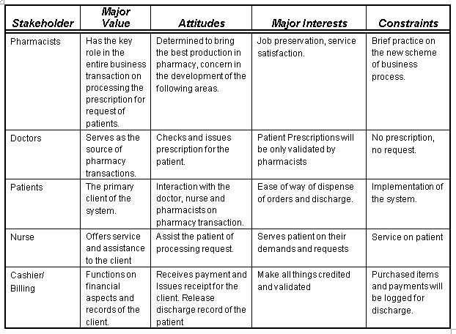
Business Context: Stakeholders Profile

Slide 19
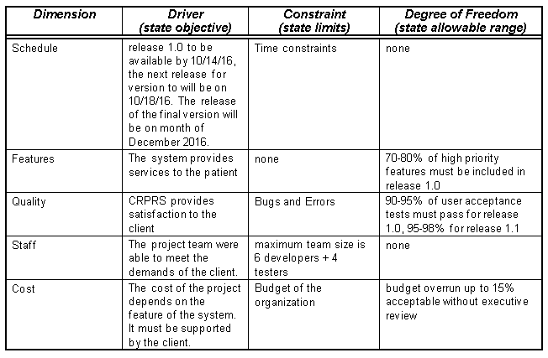
Project Priorities

Slide 20
Operating Environment
The deployment of the system will be successful if it meets the following criteria:
Stable network connection from the nurse station to pharmacy department up to billing section.
Computers and other peripherals are working and maintained properly to prevent occurrence of technical interruptions.
The users (pharmacists, nurse, cashier) are capable to use system.
Utilizing authorization protocols to secure usage of the system.

Slide 21
Thank you!

